Slide 1
ConnectX Kaggle competition Reinforcement Learning on a two-player game
Max Serra Lasierra
Project for the course “Machine Learning 2” WS22/23
University of Potsdam

Slide 2

Problem setting – Connect4

Slide 3
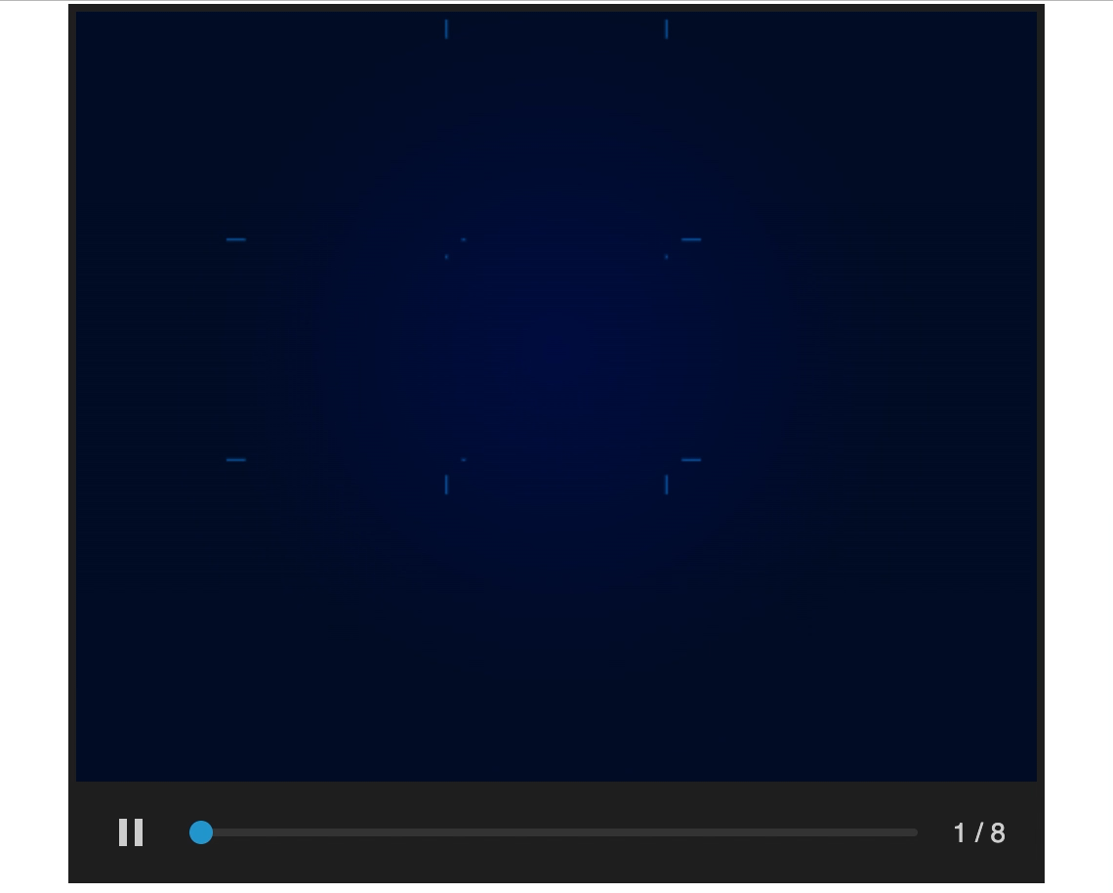
Problem setting – TicTacToe

Slide 4
My approach to the project
Align code to reference libraries:
Gym for environments
Stable Baselines3 for algorithms
Weights and Biases for tracking and evaluating
Select algorithms to use
Define evaluation of agents
Code available on github: https://github.com/maxserra/ml2_project_connectx

Slide 5
My approach to the project – Evaluation
How to evaluate an agent?
Play against another agent
Average cumulative reward
Win rate is a special case with the reward set to 0 – 1
How do we choose the reward function?
Do we program game rules on the agent?
Or, do we let the agent learn them?

Slide 6
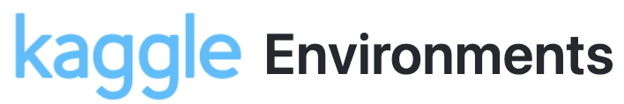
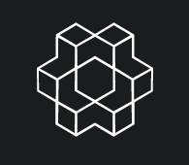
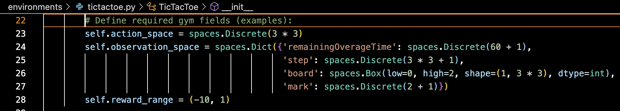
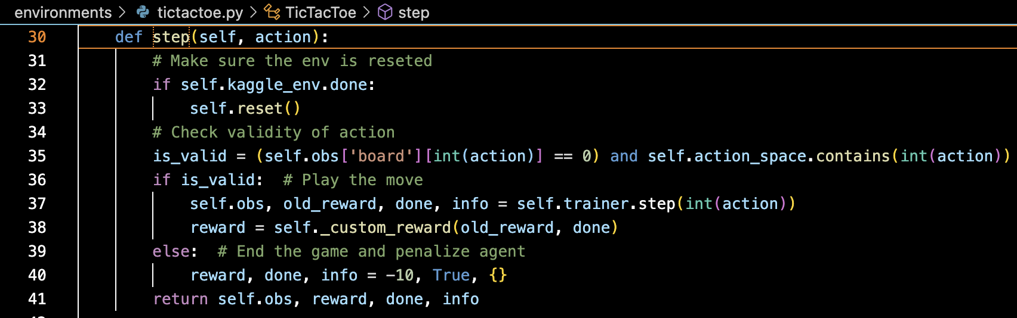
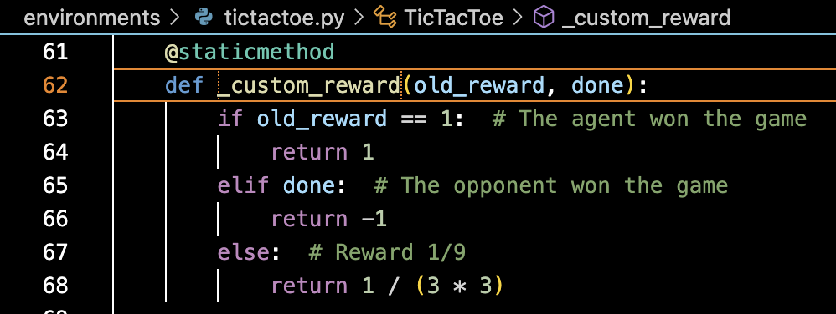
TicTacToe environment
Based on Kaggle environment, adapted to Gym

Slide 7
My approach to the project – Algortihms
Which algorithms could we use?
Temporal-Difference:
Q-Learning
(Expected) Sarsa
Monte Carlo Tree Search

Slide 8
My approach to the project – Algortihms
Which algorithms could we use?
Temporal-Difference:
Q-Learning
(Expected) Sarsa
Monte Carlo Tree Search
Deep Reinforcement Learning (“out-of-the-box” from Stable Baselines3)
DQN
PPO

Slide 9
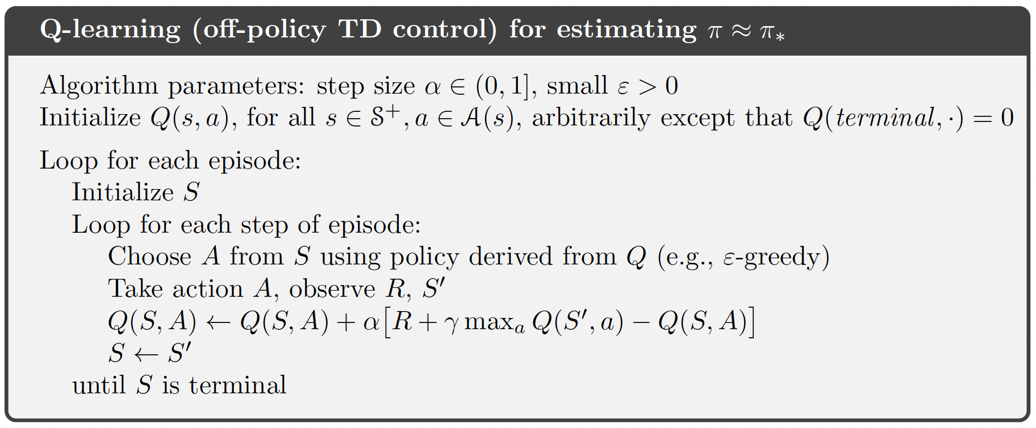
Q-Learning
Sutton and Barto, 2020

Slide 10
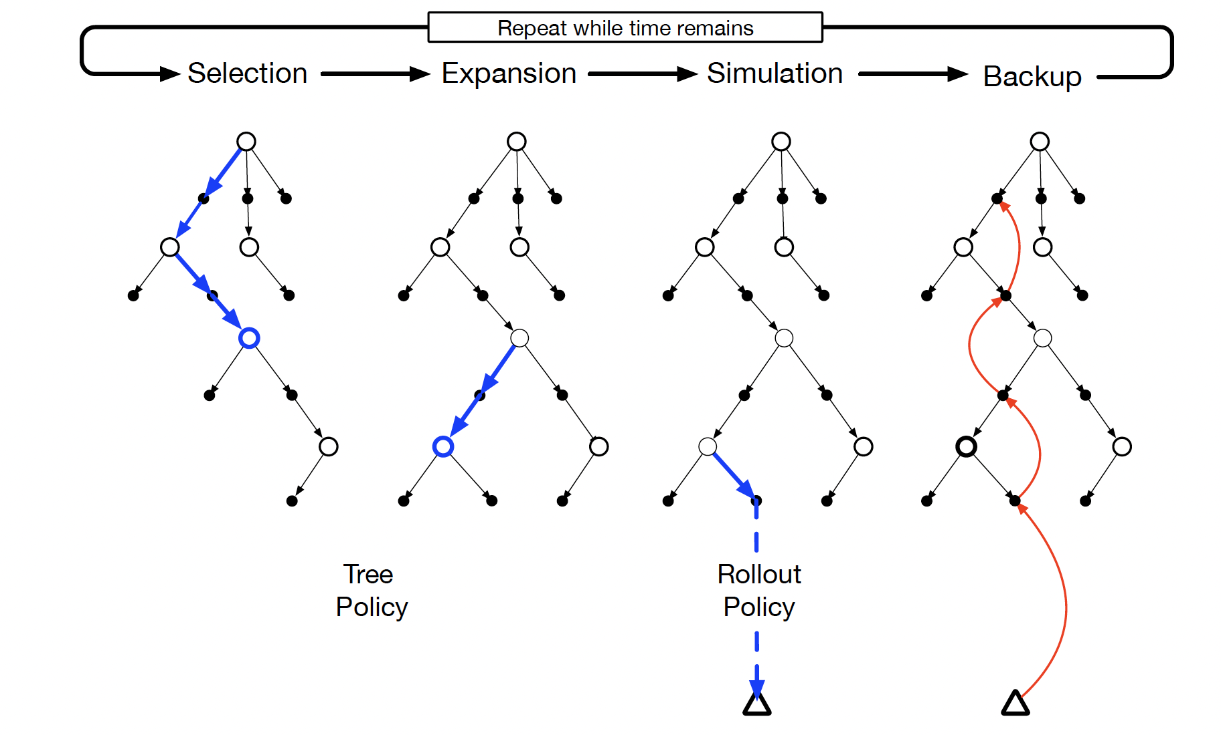
MCTS
Sutton and Barto, 2020

Slide 11
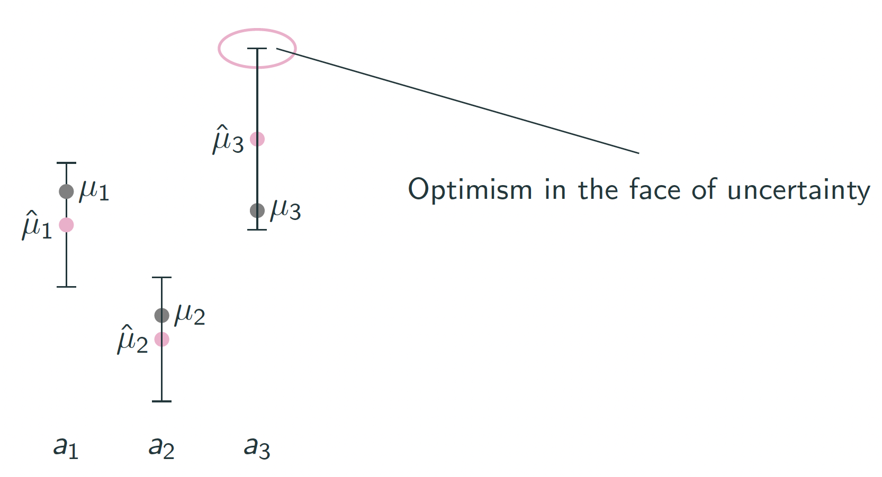
MCTS – Upper Confidence bound for Trees (UCT)

Slide 12
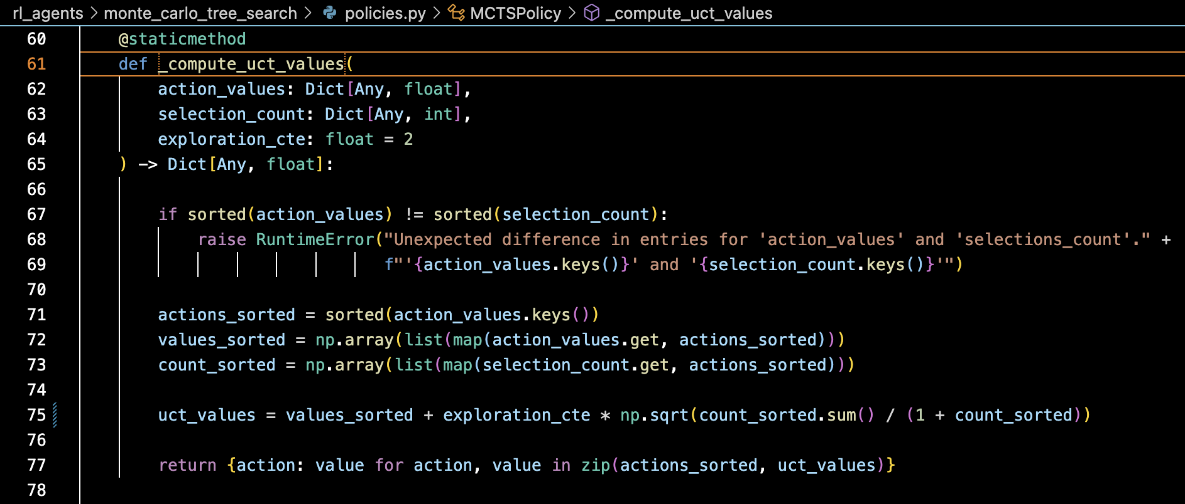
MCTS – Upper Confidence bound for Trees (UCT)

Slide 13
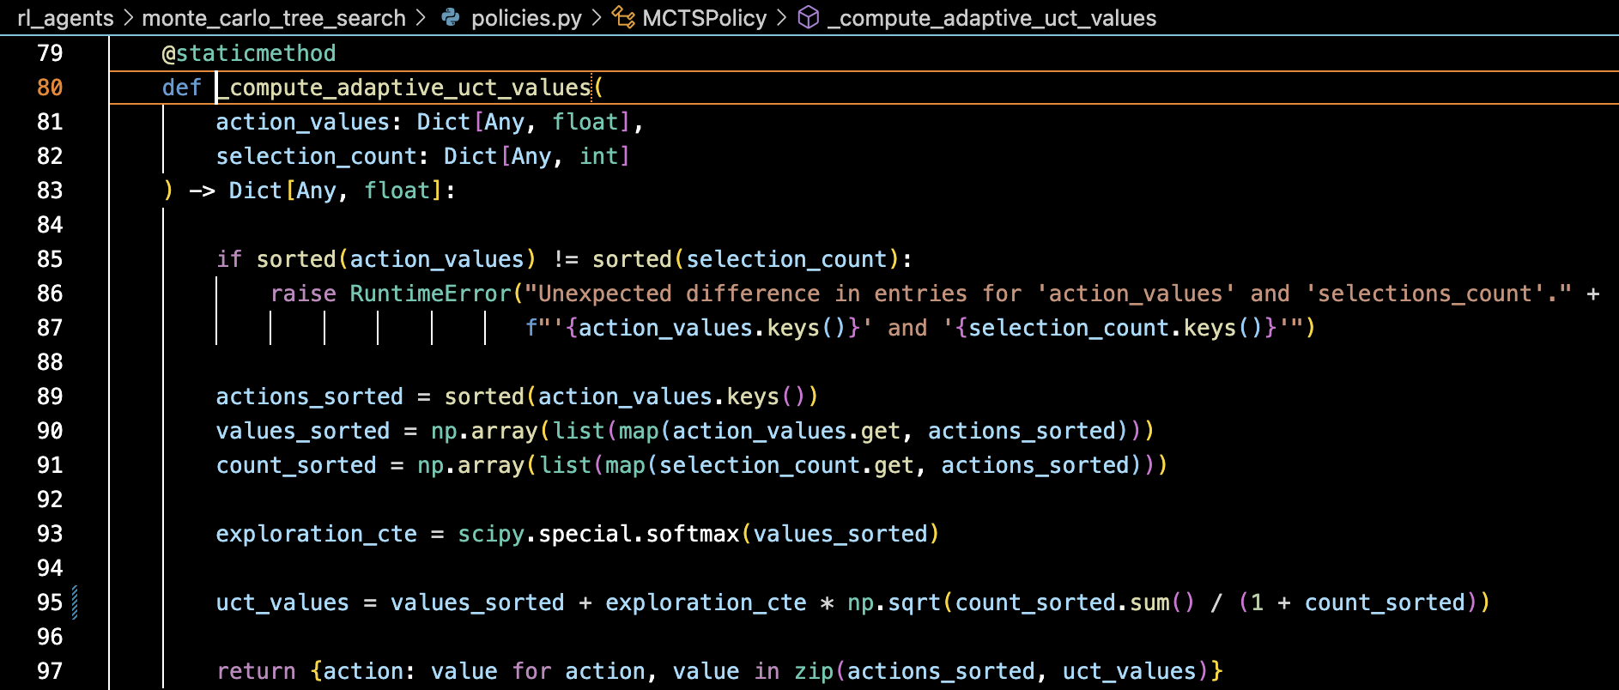
MCTS – Adaptive UCT

Slide 14
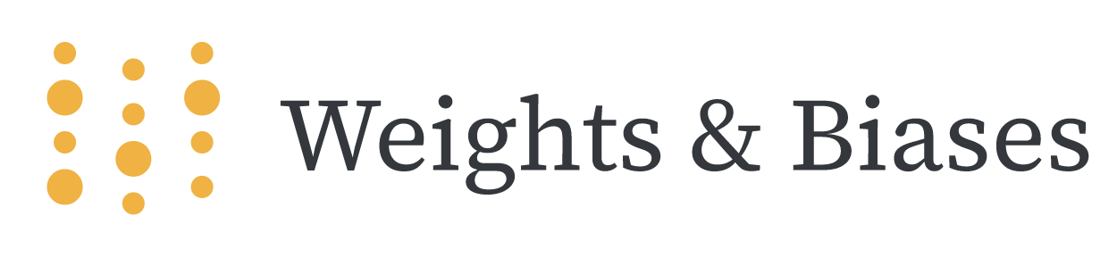
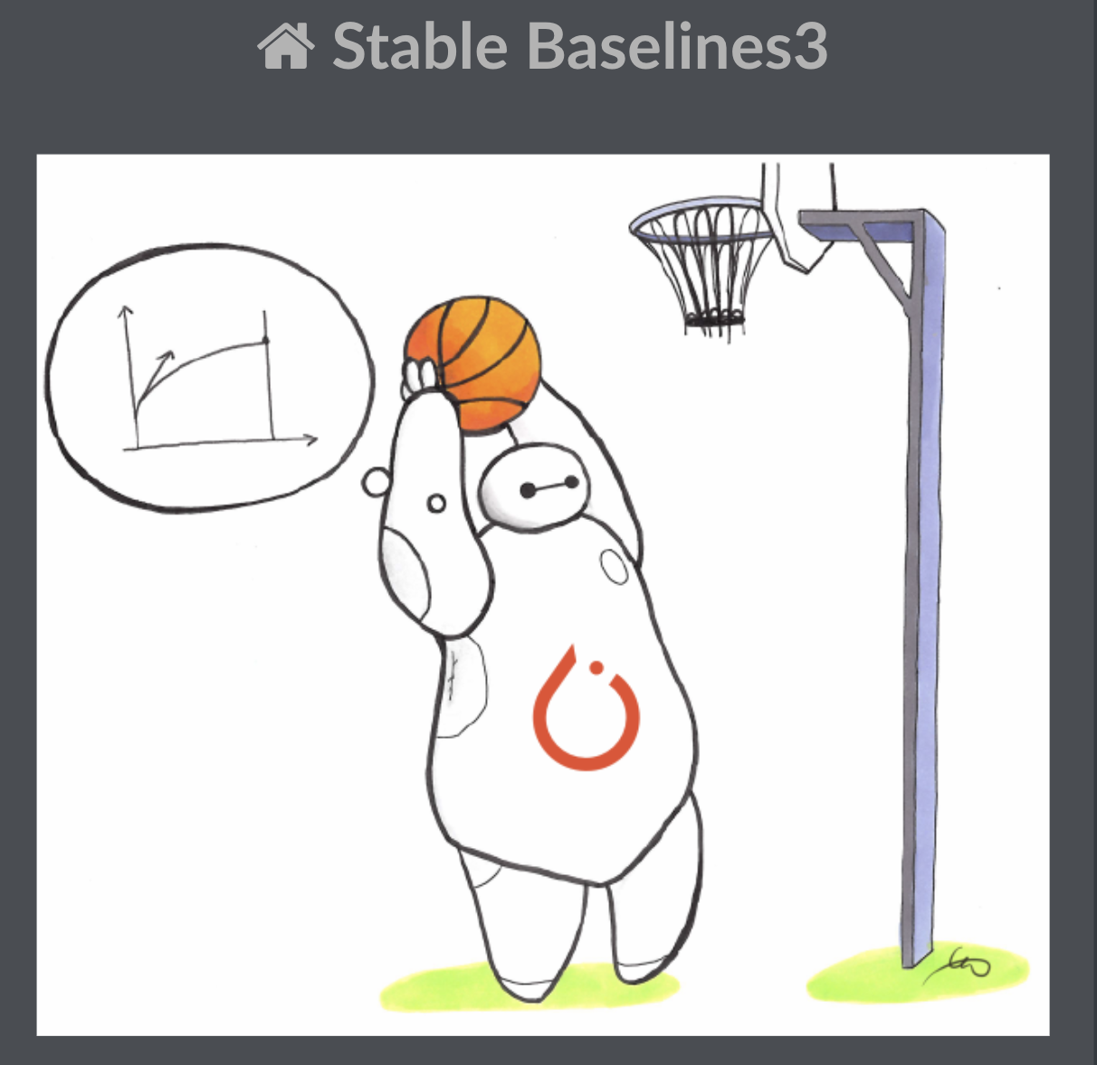
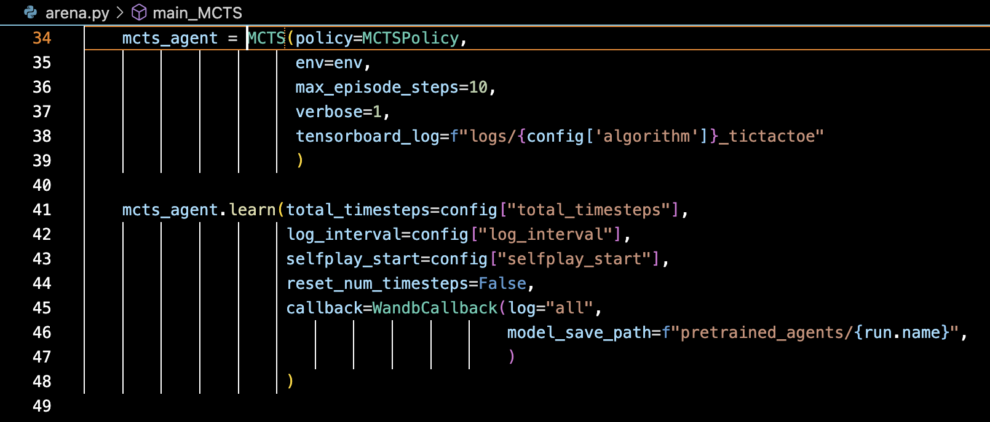
The algorithms I coded
Temporal Difference:
Q-Learning
Sarsa and expected Sarsa
Monte Carlo Tree Search

Slide 15
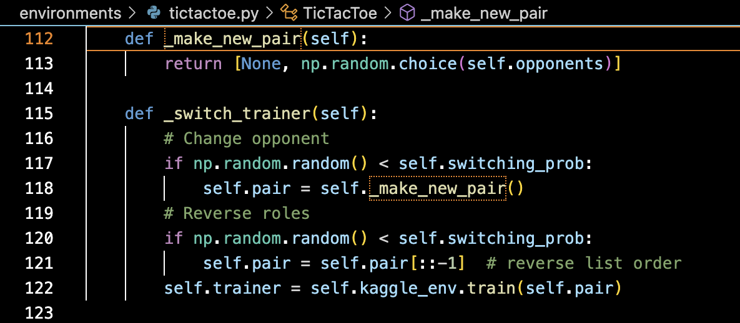
The algorithms I coded
The agent should learn to play both X and O!

Slide 16
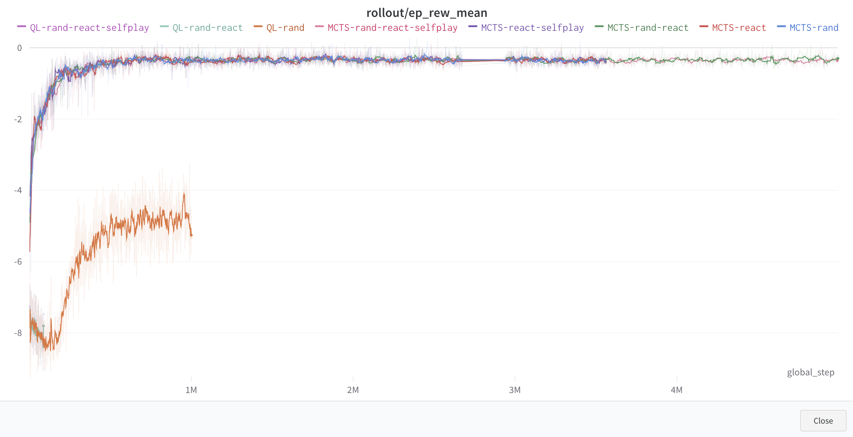
The algorithms I coded – wandb project

Slide 17
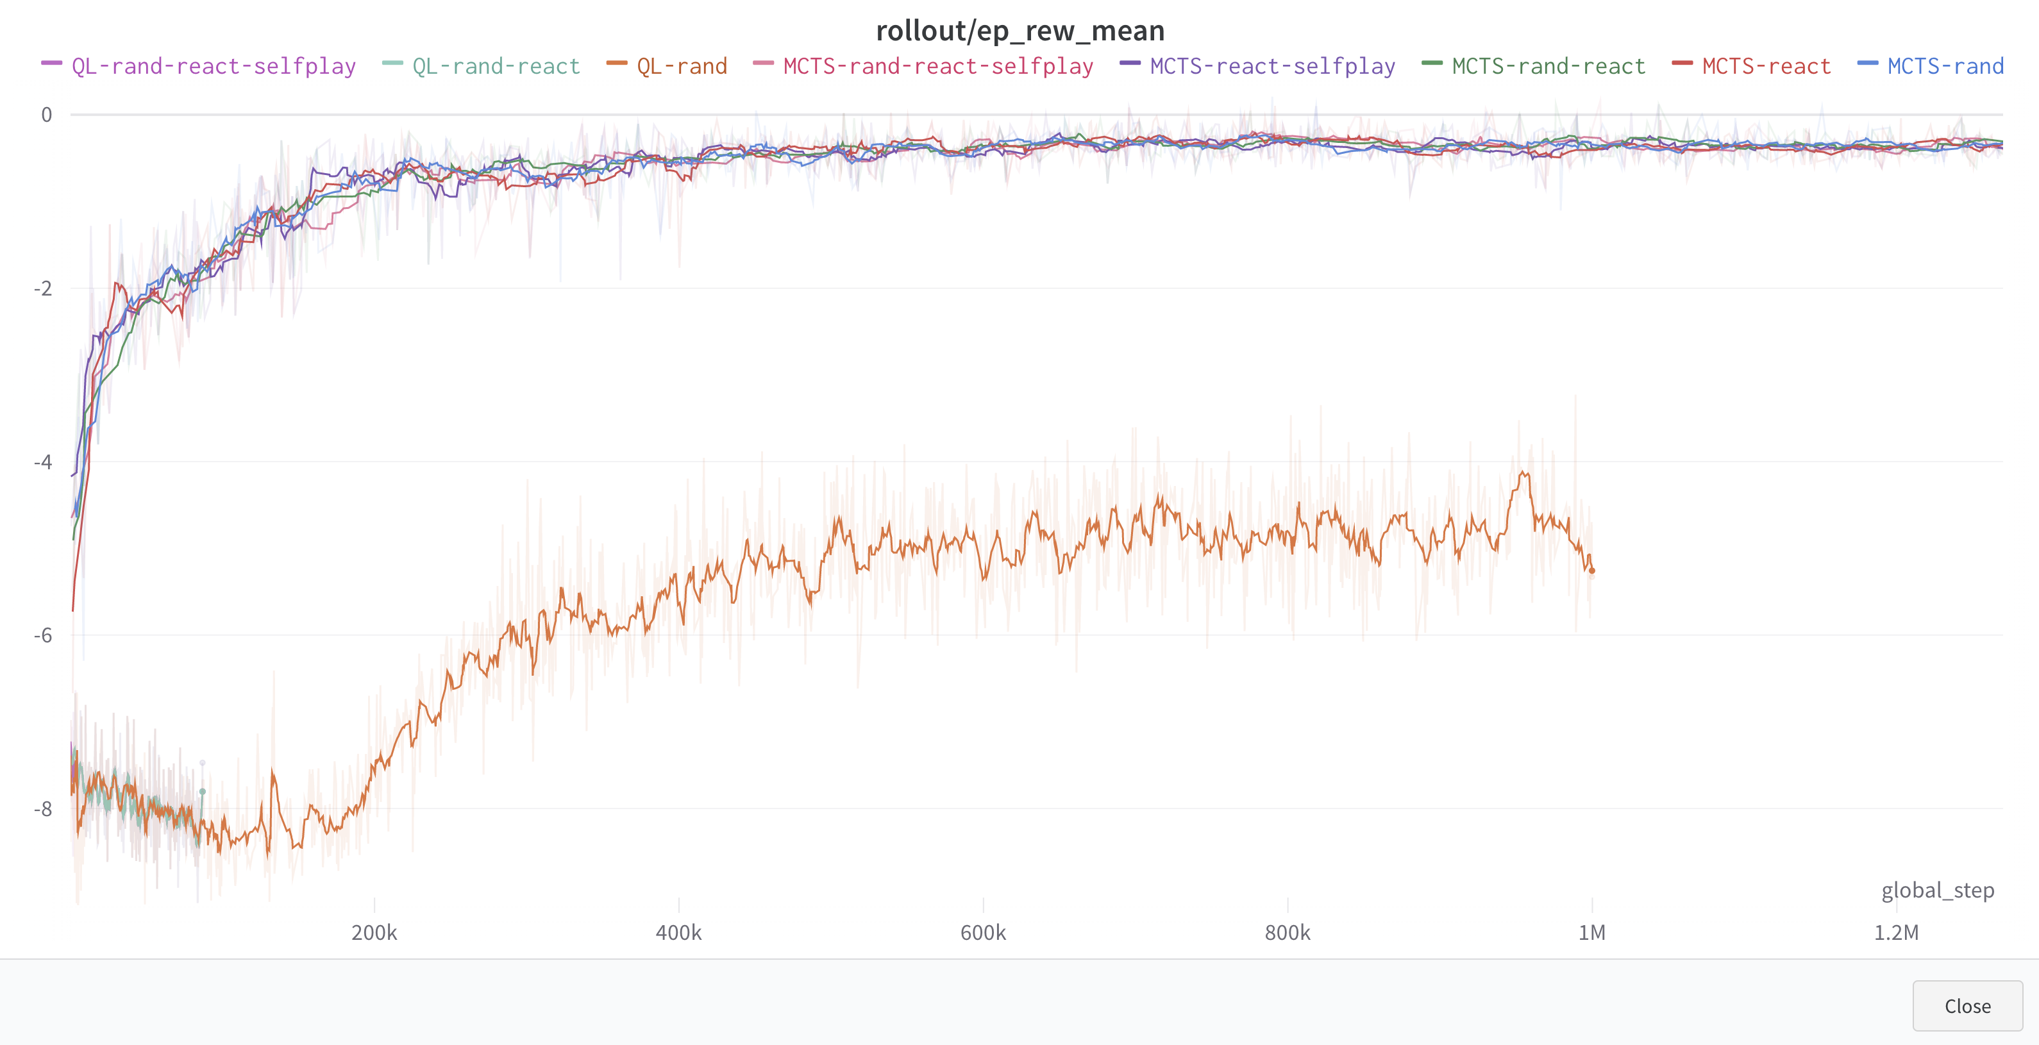
The algorithms I coded – wandb project

Slide 18
The algorithms I did not code
Deep Reinforcement Learning (“out-of-the-box” from Stable Baselines3)
DQN (Deep Q Network)
PPO (Proximal Policy Optimization)
The NN is (obviously) exposed and can be modified.

Slide 19
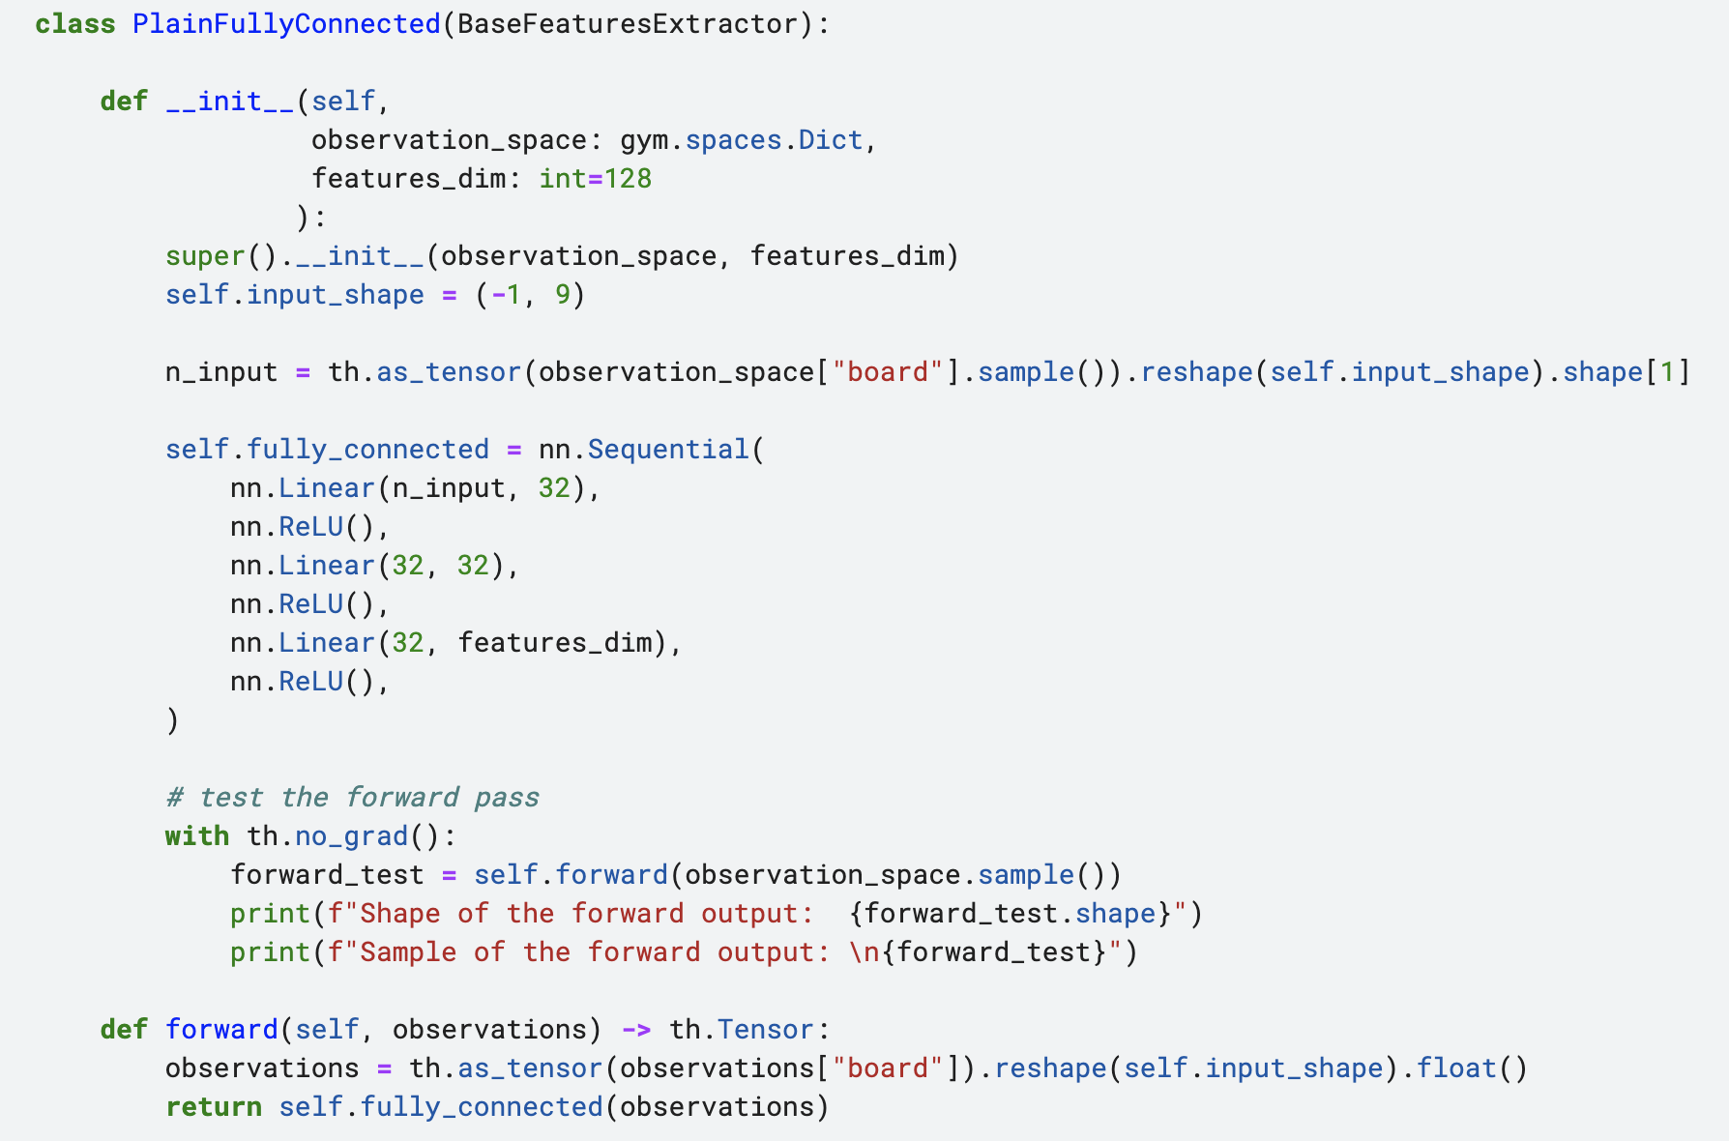
The algorithms I did not code – Kaggle notebook

Slide 20
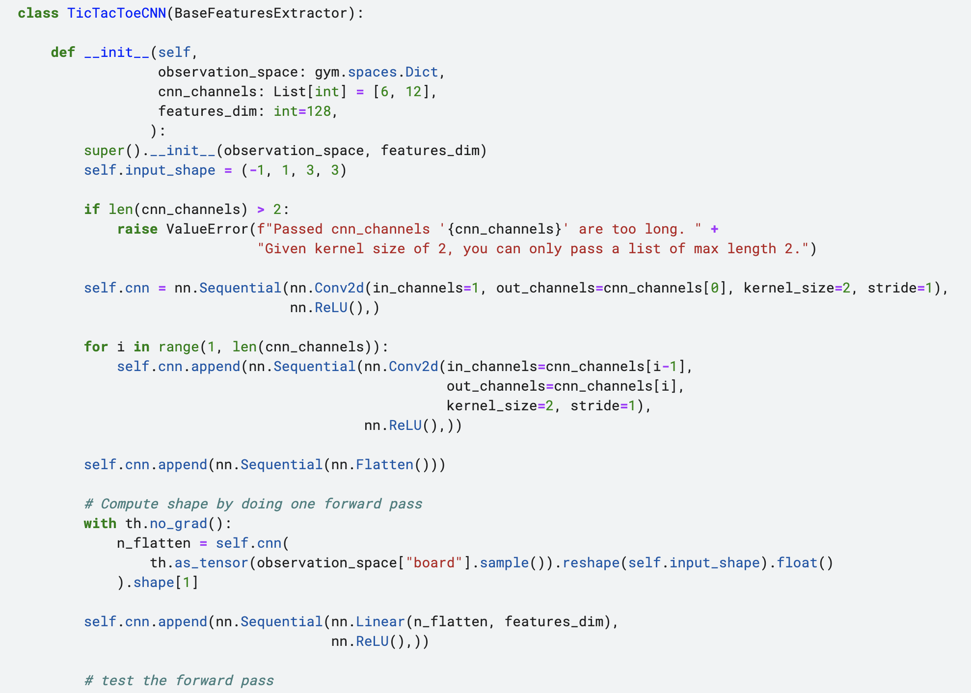
The algorithms I did not code – Kaggle notebook

Slide 21
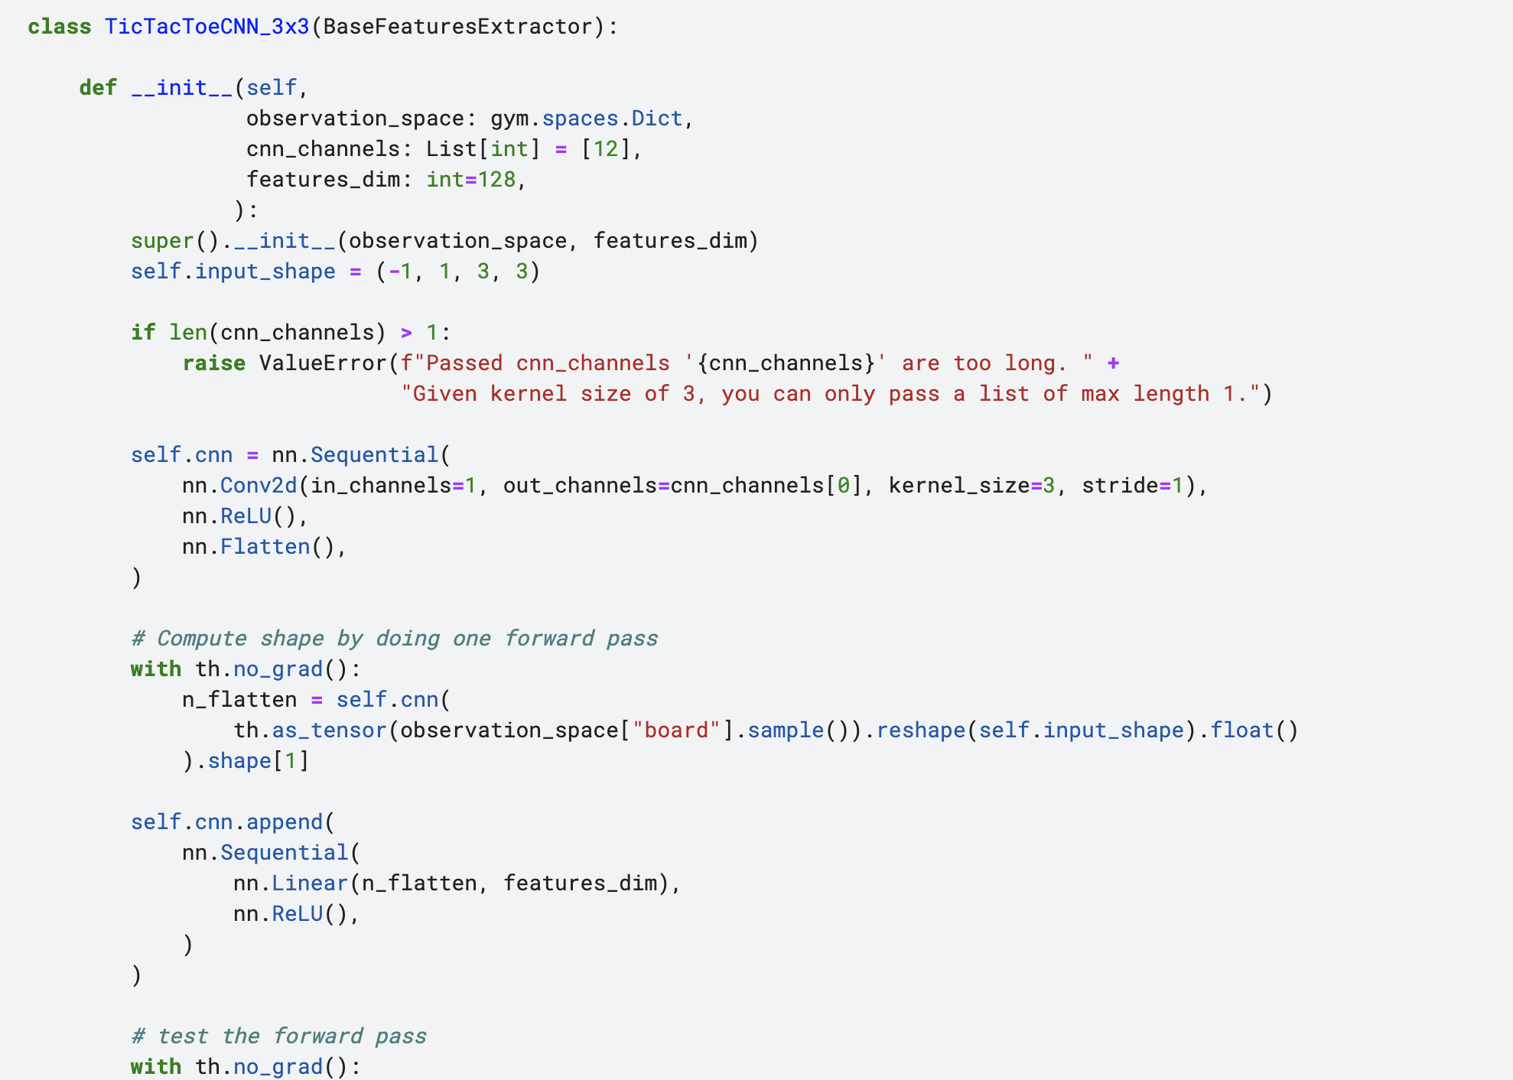
The algorithms I did not code – Kaggle notebook

Slide 22
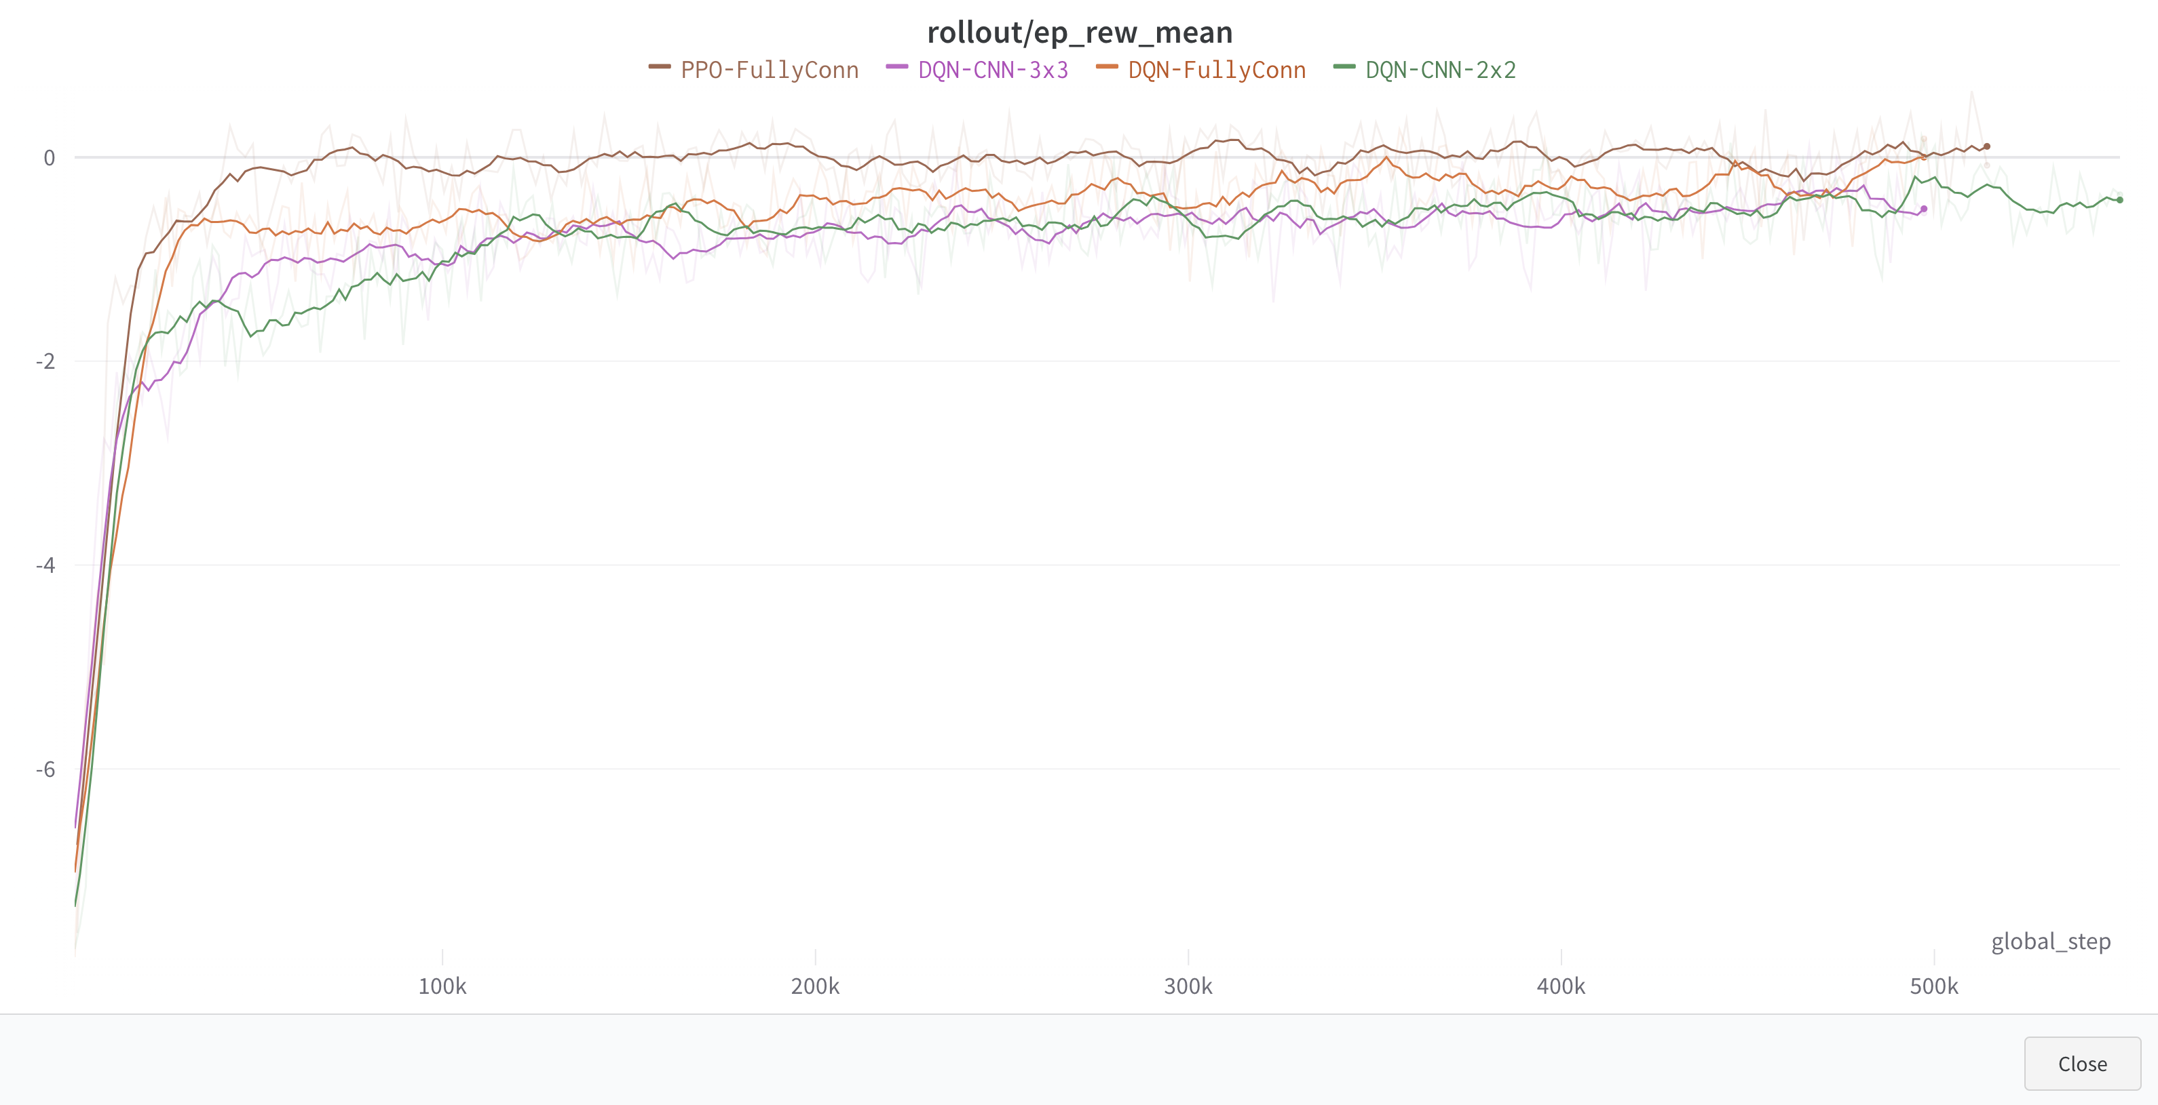
The algorithms I did not code – wandb project

Slide 23
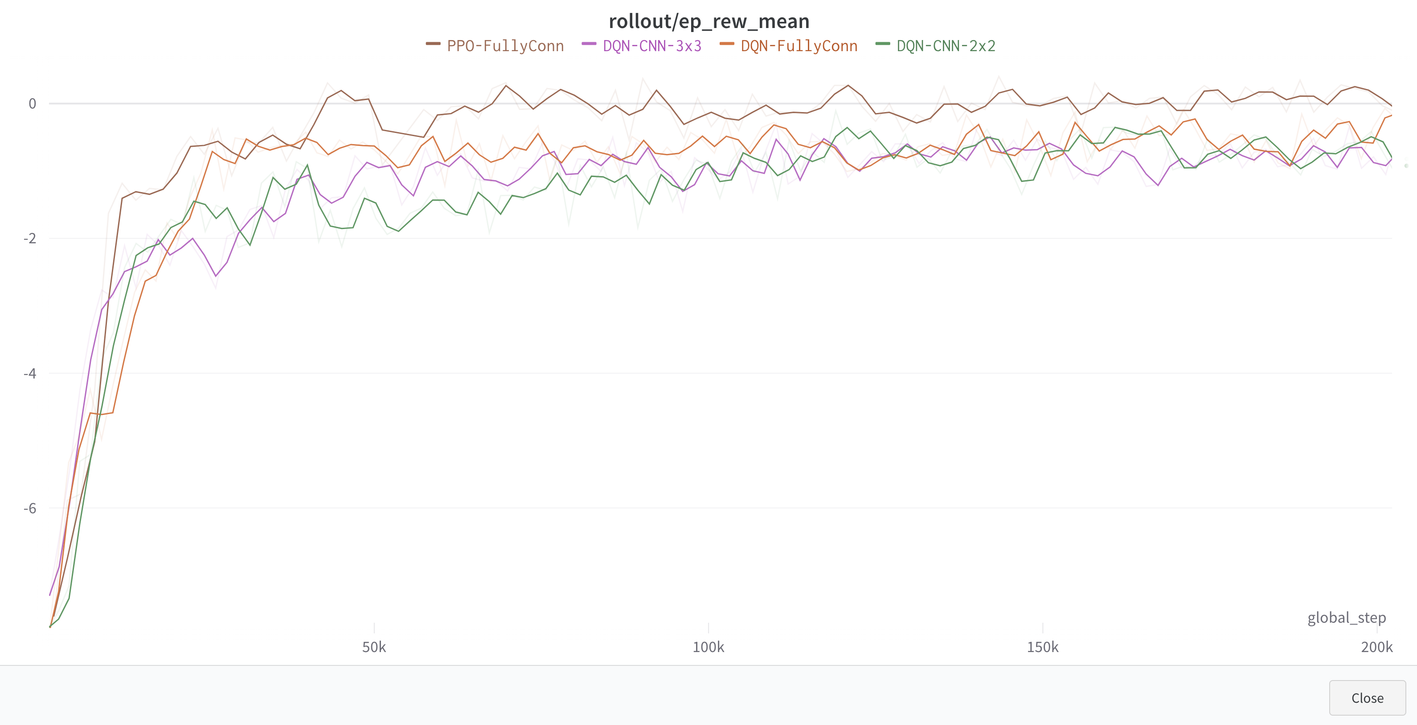
The algorithms I did not code – wandb project

Slide 24
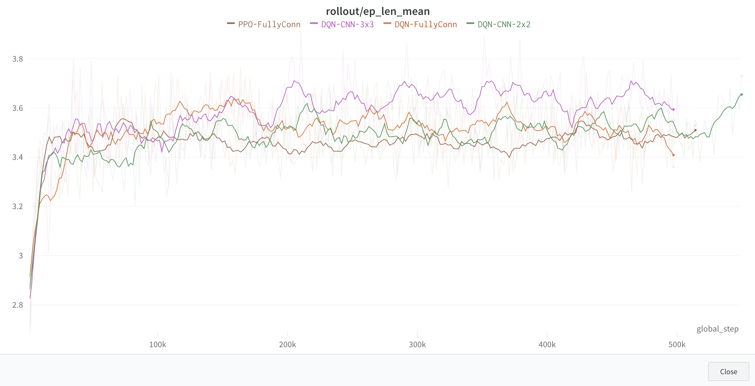
The algorithms I did not code – wandb project

Slide 25
The algorithms I did not code – wandb project

Slide 26
Conclusions and outlook
MCTS outperforms Q-Learning
DeepRL is very promising
Investigate why Q-Learning underperformed so much
Investigate why selfplay did not have an impact
Tune NN hyperparameters
Actually train an agent for Connect4 and submit it to Kaggle!

Slide 27
Questions on the project

